Slide 1
Loop Control Statements

Slide 2
Write a Program!
Write a C program that will print numbers 1 through 10 on screen.
Write a C program that will print numbers 1 through 1000 on screen.
printf(“1 2 3 4 5 6 7 8 9 10”);

Slide 3
Write a Program!
Write a C program that will print following line 10 times on screen.
“I love C.”
Write a C program that will print following line 100 times on screen.
“I love C.”
printf(“I love C.”);
printf(“I love C.”);
.
.
.
printf(“I love C.”);

Slide 4
Program Control Statements
Control statements control the flow of execution in a program or function.
There are three kinds of execution flow:
Sequence:
the execution of the program is sequential.
Selection:
A control structure which chooses alternative to execute.
Repetition:
A control structure which repeats a group of statements.

Slide 5
Loop!
Loop statement allows one or more statement(s) to be repeated.
The C has three loop control statements
for loop
while loop
do-while loop

Slide 6
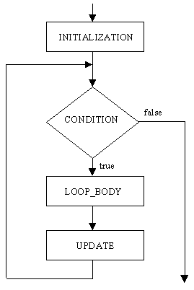
Flowchart

Slide 7
THE for LOOP!
Most flexible loop in C.
Allows a large number of variations
The for loop is used to repeat a statement or block of statements a specific number of times.

Slide 8
THE for LOOP!
Its general form for single statement-
General form for multiple statements-
for(expression 1; expression 2; expression 3)
statement;
for(initialization; conditional-test; increment)
statement;
for(initialization; conditional-test; increment)
{
statement 1;
statement 2;
…………
}
Loop Body

Slide 9
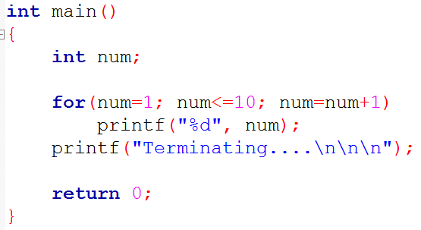
Write a C program that will print numbers 1 through 10 on screen.
Loop control variable

Slide 10
for(initialization; conditional-test; increment)
Used to give an initial value to the variable that control the loop.
Loop control variable
The initialization section execute only once, before the loop begins.

Slide 11
for(initialization; conditional-test; increment)
The conditional-test portion of the loop tests the loop-control variable against a target value.
If the conditional test evaluates true, the loop repeats.
If it is false, the loop stops and program execution picks up with the next line of code that follows the loop.

Slide 12
for(initialization; conditional-test; increment)
The increment portion is executed at the bottom of the loop.
The increment portion is executed after the statement or block that forms its body has been executed.
The purpose of the increment portion is to increase (or decrease) the loop-control value by certain amount.

Slide 13
Analyzing the Program
Loop control variable
Increment
Initialization
Condition-test
Loop body
Next line of code after loop

Slide 14
Execution
10
3
Variable(s)
num
1
Unknown
Value
11
2
OUTPUT
1
2
3
4 5 6 7 8 9 10
Terminating.
False!!
True!
Bypassing loop body
Continuing this way…

Slide 15
Execution
10
3
Variable(s)
num
1
Unknown
Value
11
2
OUTPUT
1
2
3
4 5 6 7 8 9 10
Terminating.
False!!
True!
Bypassing loop body
Continuing this way…

Slide 16
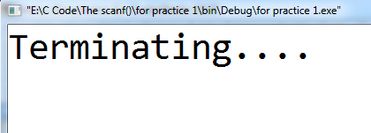
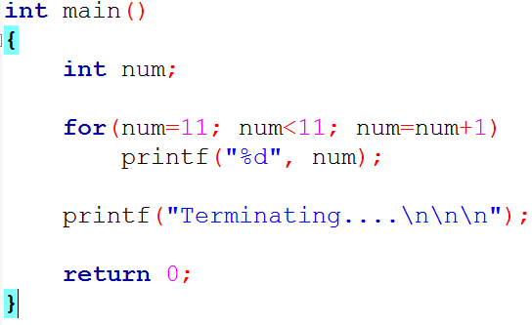
Output?

Slide 17
Program
Write a C program that will print all numbers between 20 to 30.
Write a C program that will print all odd numbers between 20 to 30.
Write a C program that will print all odd numbers between 20 to 30 and calculate their sum.

Slide 18
Infinity Loop!
for loop Variation
for( ; ; )
{
//loop body
}
for( i=0; i<10; i--)
{
//loop body
}
for( i=0; i>-1; i++)
{
//loop body
}

Slide 19
While Loop
General format:
Loop works by repeating its target as long as the expression is true.
When false, it stop.
If the expression is false to begin with, the loop will not execute even one!
while(expression)
statement;

Slide 20
Execution
10
3
Variable(s)
num
1
Unknown
Value
11
2
OUTPUT
1
2
3
4 5 6 7 8 9 10
Terminating.
False!!
True!
Bypassing loop body
Continuing this way…

Slide 21
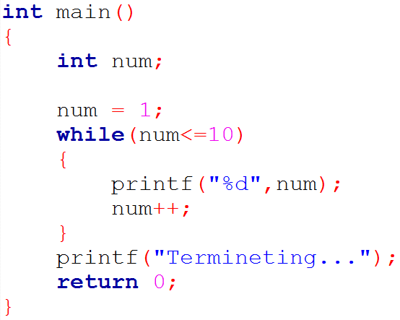
Execution
11
1
Variable(s)
num
10
Unknown
Value
3
2
OUTPUT
1
2
3
4 5 6 7 8 9 10
Terminating.
False!!
True!
Bypassing loop body
Continuing this way…

Slide 22
do …… while
do
{
statement;
}while(expression);
Here the while that ends the do is part of a do loop; not the beginning of a while loop.
;

Slide 23
do …… while
The do loop repeats the statement or statements while the expression is true.
It stops when the expression becomes false.
do loop is unique because it will always execute the code within the loop at least once.
Cause the expression controlling the loop is tested at the bottom of the loop.

Slide 24
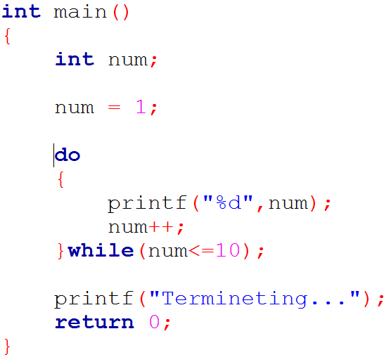

Slide 25
While vs do-while
In while loop - if the expression is fals to begin with, the loop will not execute even one!
In do loop - it will always execute the code within the loop at least once.
Cause the expression controlling the loop is tested at the bottom of the loop.

Slide 26
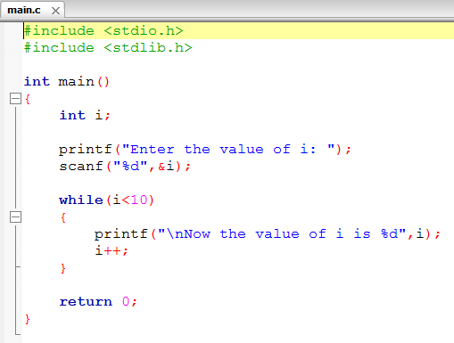
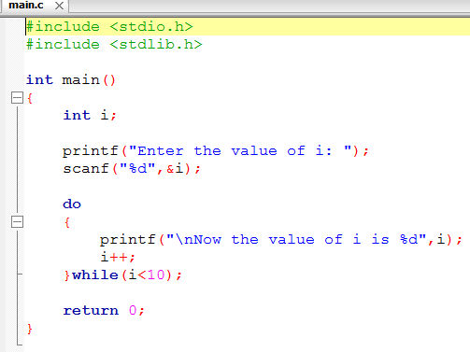
While vs do-while
while
do-while

Slide 27
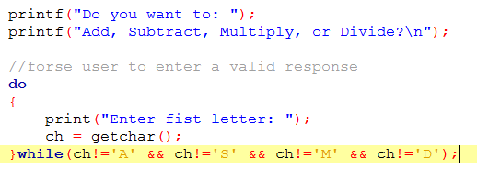
While vs do-while

Slide 28
USE break TO EXIT A LOOP
The break statement allows us to exit a loop from any point within its body, bypassing its normal termination expression.
When the break statement is encountered inside a loop, the loop is immediately stopped and program control resumes at the next statement following the loop

Slide 29
USE break TO EXIT A LOOP
Can use with all three of C’s loops.
Can use many break statement in a loop
But too many exit points from a loop tend to destructs our code
Generally best to use the break for special purpose, not as our normal loop exit.

Slide 30
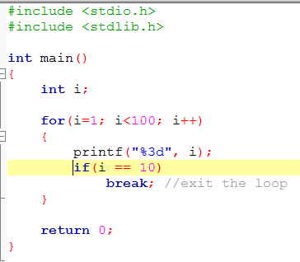
USE break TO EXIT A LOOP
Example: break;

Slide 31
USE THE continue STATEMENT
The continue statement is somewhat the opposite of the break statement.
It forces the next iteration of the loop to take place, skipping any code in between itself and the test condition of the loop.
Seldom used!

Slide 32
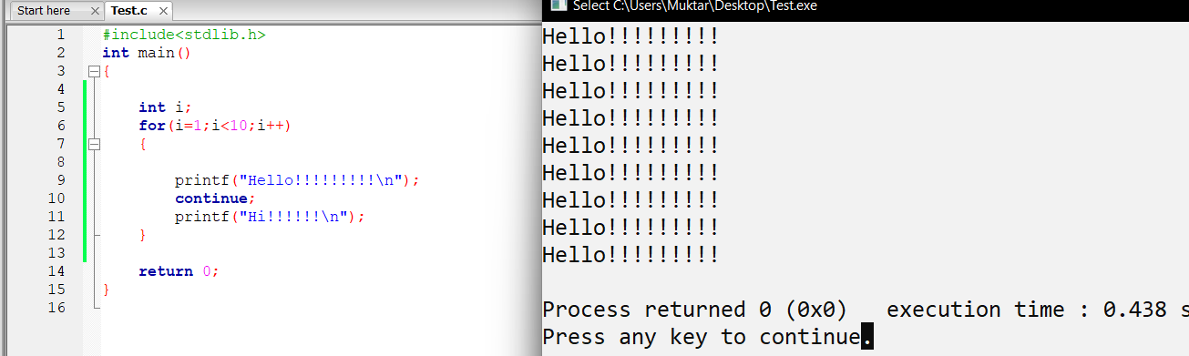
USE THE continue STATEMENT
Example: continue

Slide 33
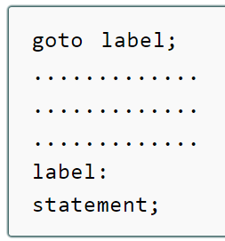
USE THE goto STATEMENT
A goto statement in C programming language provides an unconditional jump from the goto to a labeled statement in the same function.
Here label can be any plain text except C keyword and it can be set anywhere in the C program above or below to goto statement.

Slide 34
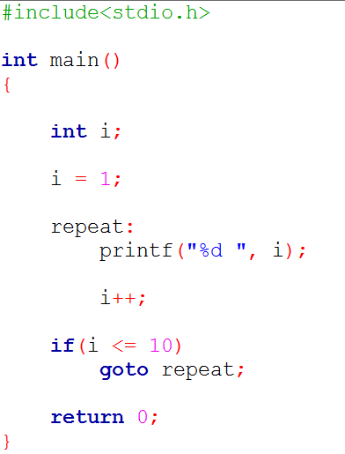
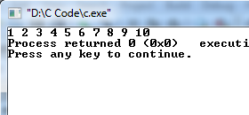
USE THE goto STATEMENT

Slide 35
Reasons to avoid goto statement
Use of goto statement is highly discouraged in any programming language because
it makes difficult to trace the control flow of a program,
making the program hard to understand and hard to modify.
Any program that uses a goto can be rewritten so that it doesn't need the goto.

Slide 36
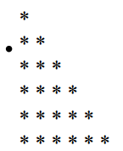
Create Nested Loops
When the body of one loop contains another loop, then the second loop is said to be nested inside the first.
Any of C’s loop may be nested within any other loop.
for(i=0; i<10; i++)
{
for(j=0; j<=i; j++) //nested
printf(“* “);
printf(“\n”);
}
Program

